Slide 1
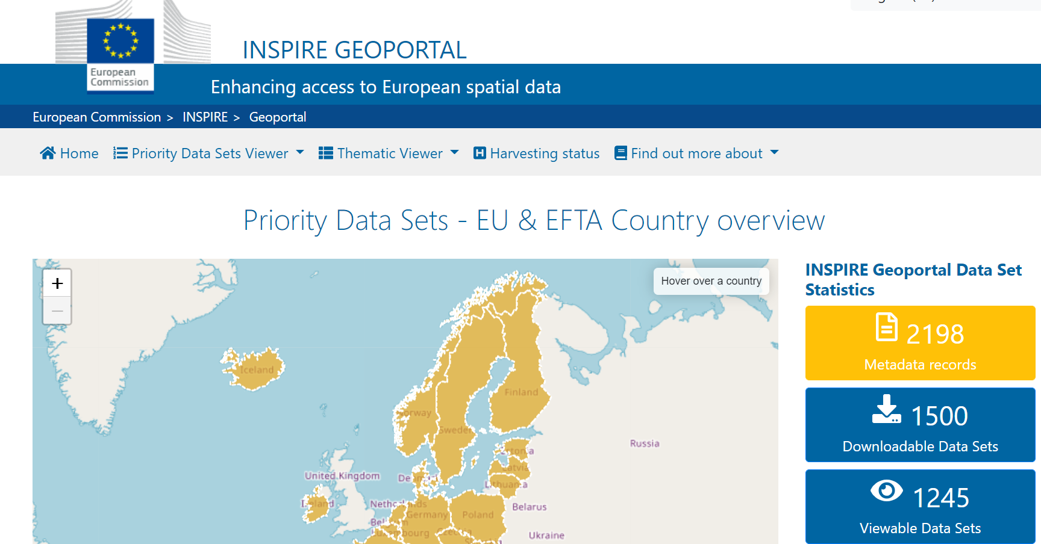
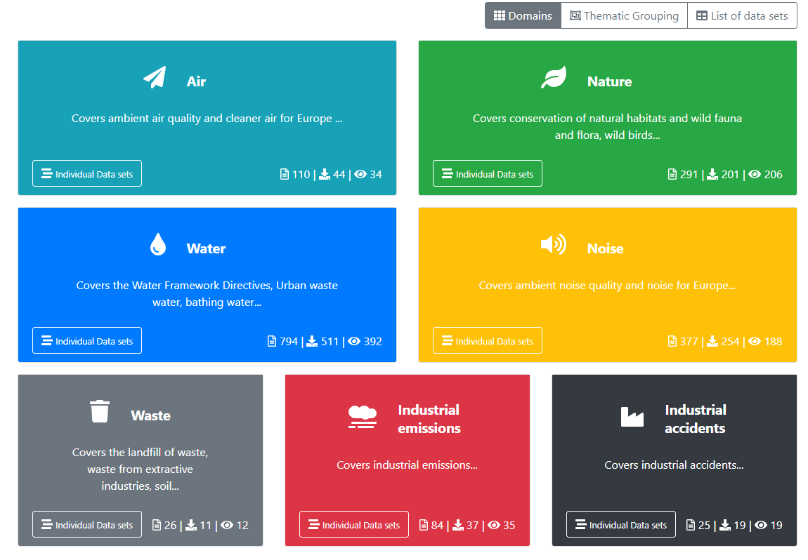
Progress on priority datasets (PDS) for eReporting
Continuous progress
since 2018
Still room for improvement regarding
access to data

Slide 2
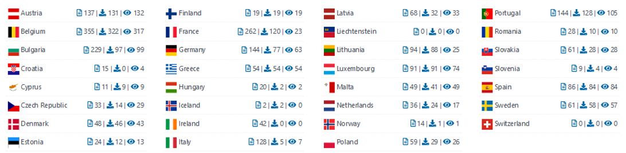
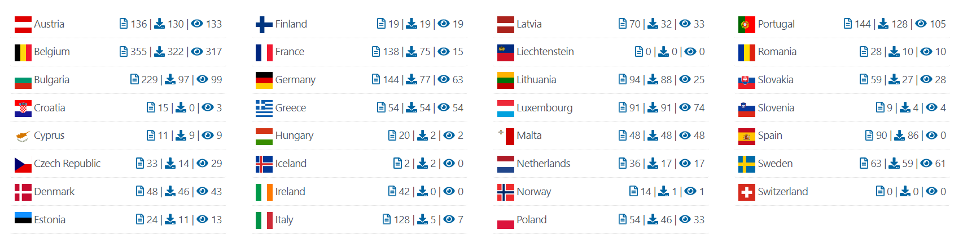
Country overview of available priority datasets
Feb.
10th
Apr.
20th
Clear underperformance
Changes February - April

